Slide 1
INTRODUCTION TO SPRING BOOT & Spring security
Srinivasulu Yepuru

Slide 2
Objective
At the end of this Session the participants will be able to understand
Basics of Spring Boot
Spring vs Spring Boot
How to develop a Spring boot application.
How enable Security using Spring Boot ?
Assessment at the End

Slide 3
Prerequisites
Spring framework basics
Spring Dependency Injection,Autowiring.
Spring IOC

Slide 4
Targetted audience
This Session on Spring Boot & Spring Security was planned for the participants of below levels:
Beginner
Intermediate

Slide 5
Tools you need
Maven 3.1+ is your build tool
Your favorite IDE. We use Eclipse.
JDK 1.8+
Postman as testing tool.

Slide 6
Spring Boot Introduction

Slide 7
Spring Boot – Introduction
Spring Boot is a framework developed on top of core spring framework.
The main aim of Spring Boot is to let developers to create spring production grade applications and services with very less effort.
In Spring, it includes writing many XML configurations, server setting, adding dependencies…etc.
But with spring Boot we can avoid all these boilerplate code, writing XML configurations and annotations.
We can create a real-time production ready applications within minutes.

Slide 8
Spring Boot – Introduction
Spring Boot comes with inbuilt server, we no longer have to use any external servers like Tomcat, Glass-fish or anything else, so don’t need to deploy WAR files .
The main advantage of Spring Boot is, we can create spring-based applications easily in very less time, without need of any XML configurations.
The main disadvantage is, it will be little tough to migrate existing spring enterprise applications to Spring Boot.
We have to use either Maven or Gradle build tool to work with Spring Boot.

Slide 9


Spring VS Spring Boot
Takes Time to have spring application up and running
Shortest way to run spring application
Required Additional web server
Embedded server to avoid complexity
Need to use some open source
Metrics, Health check using actuator
Dependencies need to be used in pom.xml
Starter used in pom.xml

Slide 10
Spring Boot Setup
Spring Boot CLI
Spring Tool Suits (STS)
Spring Initializer

Slide 11
First Spring Boot Application using Maven

Slide 12
Spring Boot + Maven
What is Spring Boot Starter Parent?
All Spring Boot projects typically use spring-boot-starter-parent as the parent in pom.xml.
<parent>
<groupId>org.springframework.boot</groupId>
<artifactId>spring-boot-starter-parent</artifactId>
<version>1.4.0.RELEASE</version>
</parent>

Slide 13
Spring Boot + Maven
Parent Poms allow you to manage the following things for multiple child projects and modules:
Configuration - Java Version and Other Properties
Dependency Management - Version of dependencies
Default Plugin Configuration

Slide 14
Spring Boot Hello World Example
package com.optum.app;
import org.springframework.boot.SpringApplication;
import org.springframework.boot.autoconfigure.SpringBootApplication;
@SpringBootApplication
public class SpringBootApp
{
public static void main(String[] args)
{
SpringApplication.run(SpringBootApp.class, args);
}
}
@SpringBootApplication annotation, means this is the starting point for our Spring Boot application

Slide 15
POM.XML
<parent>
<groupId>org.springframework.boot</groupId>
<artifactId>spring-boot-starter-parent</artifactId>
<version>1.5.6.RELEASE</version>
</parent>
<dependencies>
<dependency>
<groupId>org.springframework.boot</groupId>
<artifactId>spring-boot-starter-web</artifactId>
</dependency>
</dependencies>
<properties>
<java.version>1.8</java.version>
</properties>

Slide 16
What is spring-boot-starter-parent?
This is an existing project given by spring team which contains Spring Boot supporting configuration
data
we have added this in a <parent> tag means, we are instructing Maven to consider us
SpringBootHelloWorld project as a child to it,

Slide 17
What is inside Spring Boot Starter Parent?
First of all - Spring Boot Starter Parent defines spring-boot-dependencies as the parent pom.
It inherits dependency management from spring-boot-dependencies.
<parent>
<groupId>org.springframework.boot</groupId>
<artifactId>spring-boot-dependencies</artifactId>
<version>1.4.0.RELEASE</version>
<relativePath>../../spring-boot-dependencies</relativePath>
</parent>
Default java version is 1.6. A project can override this by specifying a property `1.8.3.1.1

Slide 18
How to Create a RESTful Web Service ?
To create a RESTful Web Service using Spring Boot ,we use below annotations.
@RestController,
@RequestMapping
The annotation @RestController, tells Spring Boot to consider this class as REST controller.
The annotation @RequestMapping register the controller with a path inside it.

Slide 19
Example :@RestController, @RequestMapping
@RestController
public class SpringJavaController {
@RequestMapping("/")
public String welcome() {
return "Welcome to Spring Boot ";
}
@RequestMapping("/hello")
public String myData() {
return "Hello Spring Boot";
}
}

Slide 20
How spring boot knows to scan our controller?
SpringJavaController.java
package com.optum.app.controller;
import org.springframework.web.bind.annotation.RestController;
import org.springframework.web.bind.annotation.RequestMapping;
@RestController
public class SpringJava4sController {
@RequestMapping("/")
public String welcome() {
return "Welcome to Spring Boot Tutorials";
}
@RequestMapping("/hello")
public String myData() {
return "Hello Spring Boot";
}
}

Slide 21
How spring boot knows to scan our controller?
If you create the controller class outside of the main package, lets say com.optum.controller, If you run the
application it gives 404 error, just give a try and see 🙂
What’s the solution for this? we have to add @ComponentScan annotation in our Spring Boot main class,
something like this..
@SpringBootApplication
@ComponentScan(basePackages="com.optum.controller")
public class SpringBootApp {
public static void main(String[] args){
---
}
}

Slide 22
How to Change Default Tomcat Server Port
when we start the application Spring Boot’s inbuilt tomcat server by default will take 8080 as its port number.
We can change that default tomcat’s port number 8080 to something else.
Ex:
application.properties
server.port = 2020

Slide 23
How to Change Default Context Path
Firstly what is this context path?
simply its our application name.
Generally while we are hitting any application in the browser, we will write the URL with the application
name(context).
Ex:
application.properties
server.contextPath=/yourApplicationName

Slide 24
How to Reload Changes Without Restarting the Server
One of the main challenge for the java developers is to deploy the apps and restart server when ever there
is a code change.
We can simplify with the help of Spring boot to reload the code changes without having to restart the
server.
In Spring Boot this can be achieved by adding a DevTools module, just add the following dependency in
your Spring Boots pom.xml and build it.

Slide 25
How to Reload Changes Without Restarting the Server
In Spring Boot this can be achieved by adding a DevTools module, just add the following dependency in
your Spring Boots pom.xml and build it.
<dependency>
<groupId>org.springframework.boot</groupId>
<artifactId>spring-boot-devtools</artifactId>
<optional>true</optional>
</dependency>

Slide 26
How to Deploy Spring Boot Applications on External Tomcat Server
we used to deploy and run the applications using embedded tomcat server provided by the spring boot.
Generally in the real-time projects we wont use inbuilt servers provided by the frameworks because of many
reasons like security, maintenance and control.You want to deploy it on to external tomcat server
Ex:
<!-- to export as WAR -->
<dependency>
<groupId>org.springframework.boot</groupId>
<artifactId>spring-boot-starter-tomcat</artifactId>
<scope>provided</scope>
</dependency>
<!-- packaging to WAR -->
<packaging>war</packaging>

Slide 27
Auto Configuration?

Slide 28
Why do we need Spring Boot Auto Configuration?
Spring based applications have a lot of configuration.
When we use Spring MVC, we need to configure component scan, Dispatcher Servlet, a view resolver, web
jars(for delivering static content) among other things.
<bean
class="org.springframework.web.servlet.view.InternalResourceViewResolver">
<property name="prefix">
<value>/WEB-INF/views/</value>
</property>
<property name="suffix">
<value>.jsp</value>
</property>
</bean>
<mvc:resources mapping="/webjars/**" location="/webjars/"/>

Slide 29
Why do we need Spring Boot Auto Configuration?
Spring Boot looks at
a) Frameworks available on the CLASSPATH
b) Existing configuration for the application.
Based on these, Spring Boot provides basic configuration needed to configure the application with these
frameworks. This is called Auto Configuration.
Ex:
import org.springframework.boot.autoconfigure.SpringBootApplication;
import org.springframework.context.ApplicationContext;
@SpringBootApplication
public class SpringBootApp{
@Autowired
private ApplicationContext context;
}

Slide 30
Display All Beans Available in ApplicationContext
To show you how to see the beans that are loaded by the Spring Boot from the ApplicationContext.
@SpringBootApplication
public class SpringBootApp implements CommandLineRunner {
@Autowired
private ApplicationContext context;
public static void main(String[] args) {
SpringApplication.run(SpringBootApp.class, args);
}
@Override
public void run(String...args) throws Exception {
String[] beans = context.getBeanDefinitionNames();
for (String bean: beans) {
System.out.println(bean);
}
}
}

Slide 31
Creating Restful web services using Spring Boot

Slide 32
How to Create a RESTful Web Service ?
To create a RESTful Web Service using Spring Boot ,we use below annotations.
@RestController,
@RequestMapping
The annotation @RestController, tells Spring Boot to consider this class as REST controller.
The annotation @RequestMapping register the controller with a path inside it.

Slide 33
How to Create a RESTful Web Service ?
SpringJavaController.java
package com.optum.app.controller;
import org.springframework.web.bind.annotation.RestController;
import org.springframework.web.bind.annotation.RequestMapping;
@RestController
public class SpringJava4sController {
@RequestMapping("/")
public String welcome() {
return "Welcome to Spring Boot Tutorials";
}
@RequestMapping("/hello")
public String myData() {
return "Hello Spring Boot";
}
}

Slide 34
How to Create a RESTful Web Service with GET Request with XML response
Spring boot services by default gives the response in JSON format,
but we can reverse this functionality in such a way that the default response will be in XML.
In order to do that we have to add a new dependency called jackson-dataformat-xml.
<dependency>
<groupId>com.fasterxml.jackson.dataformat</groupId>
<artifactId>jackson-dataformat-xml</artifactId>
</dependency>

Slide 35
Spring Boot Security

Slide 36

Agenda
Introduction
Passwords & Crypto
Basic Authentication
Authorization
Form Based Authentication
JWT Authentication
Q&A

Slide 37
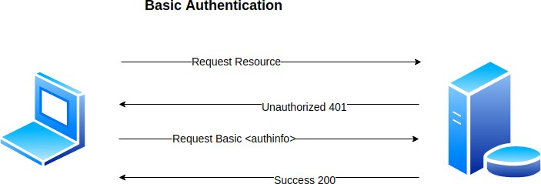
Basic Authentication
It is the simplest of authentication mechanisms. It is a part of HTTP protocol. It is a challenge response scheme where the server challenges the client to provide necessary information to access the resource
How does it work?
Get the username and password from user
Encode it using base64 algorithm
Set it in the Authorization header and send it along each HTTP Request.
GET Request | Basic64:username:password

Slide 38
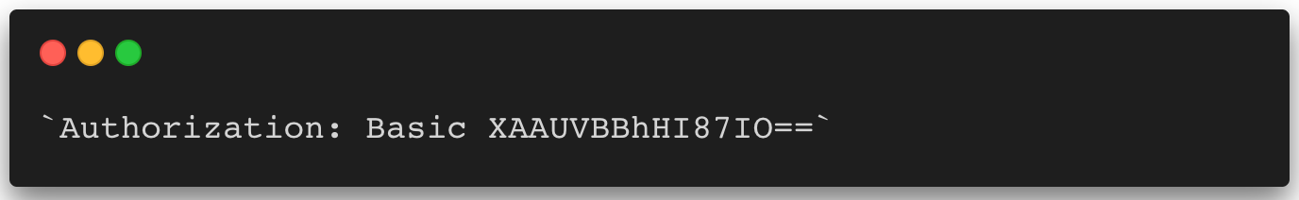
Basic Authentication
Advantages
Easy and simple to implement
APIs are faster since there is no complex encryption/decryption involved
Disadvantages
Basic Auth implemented in a non-SSL (HTTPS) network is a huge security vulnerability. It is easy to decode an Base64.
Sending passwords over all the HTTP request provides a pool of requests for attackers to pick passwords from. Once they crack one the system becomes open for attacks.

Slide 39

User
UserName (Unique)
Password (Encoded) Role
Authority / Privileges Locked
Expires

Slide 40
Authorization
Authorization is something that happens once the user logs into the system. Does an user have access to a specific information? For example, in a library the lenders need not know the billing/vendor information related to each book. In a system that involves more than one type of stakeholders, the authorization is as important of authentication.
Access-Control
Authorization is achieved using access control, you can imagine it as a “Restricted Area” sign with a guard.
Types of Access Control
RBAC - Role Based Access Control - A user with specific roles can access specific data. E.g., Only a Super Admin can change the Locale of the system. MAC - High security systems avail these kinds of access control
DBAC White-Lists & Black-Lists - Discretionary Access Control - The business data decides which information is available for a specific user.

Slide 41

Role
Read
Read
Write
Role: Admin
Role: User
Permission X1 Permission X2 Permission X3 Permission Y1 Permission Y2 Permission Y3
Permission X1 Permission X2 Permission X3

Slide 42
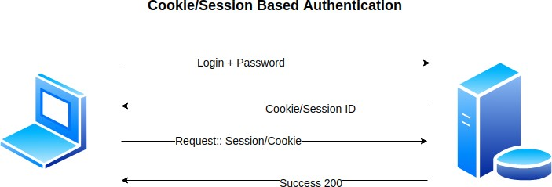
Form Based Authentication (Cookie / Session)
Cookie/Session based authentication is the most used in web apps. Yes, both session and cookie are not the same but the conceptually either the client uses a cookie/session to identify itself as a logged in.
How does it work?
Get the username and password from user
Set it in request form params and send it to the server
Server validates the user based on the given username and password
Once successful validation, create a cookie and set it in the response
The client then uses this cookie/session to make future requests.

Slide 43
Form Based Authentication (Cookie / Session)
Advantages
We no longer set the password in every request making the window for attacks smaller.
Enables state maintenance in a stateless system. Cookies maintain the state that the user is already logged in.
Can revoke the validity of a cookie anytime.
Disadvantages
Cookie based authentication is suitable only for Single domain system. If you want both a web and a mobile app or may be a separate client server, then you got to deal with CSRF.
Prone to XSS and CSRF attacks since the cookie is available for other apps to read
You need to store the session information in a DB which also brings in the question of scale

Slide 44
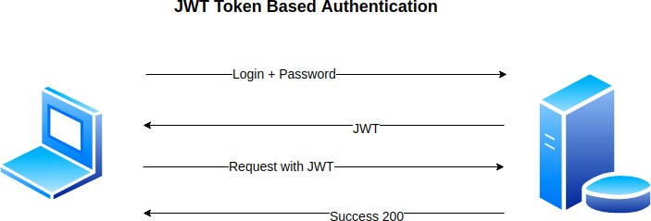
Token Based Authentication(JWT)
Token Based Authentication is a form of stateless authentication. Instead of sending email and password over for authentication we use a server generated token. Oauth, JWT, Open ID all comes under token-based authentication
How does it work?
User submits a username and password
Server validates and returns a singed token JWT
Use the token to allow future requests

Slide 45
Token Based Authentication(JWT)
Advantages
The server no longer have to bear the overhead of session information
No more CSRF. With token based auth you are dealing with a bunch of APIs consumed by different clients
Works well on microservices architecture.
Disadvantages
Cannot revoke the access to a user.
The safety of the token relies on the consumer of the token.

Slide 46
References
Spring Security 5.x.x
https://start.spring.io/
https://spring.io/projects/spring-security
https://docs.spring.io/spring- security/site/docs/5.3.4.RELEASE/reference/html5/
https://docs.spring.io/spring- security/site/docs/5.3.4.RELEASE/api/
https://docs.spring.io/spring- boot/docs/current/reference/html/appendix-application- properties.html#security-properties

Slide 47

Any Questions ?

